Slide 1

The Machine Learning Process
How do I explore a pandas Series?
Dr. Reza Dibaj

Slide 2
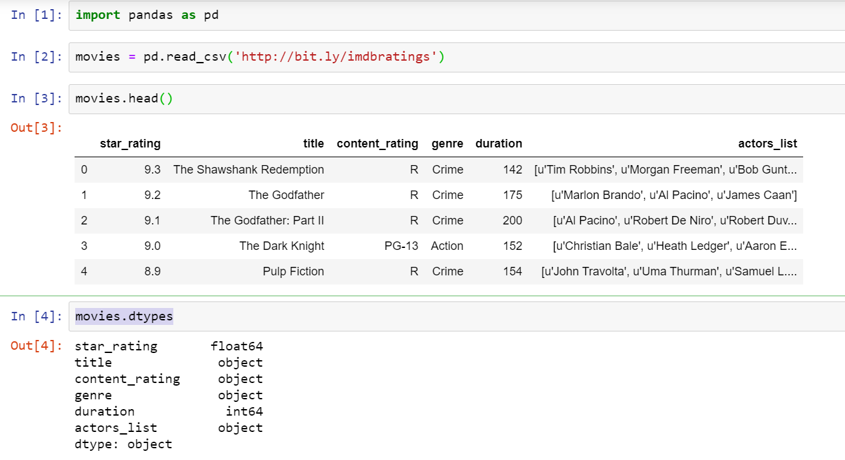
How do I explore a pandas Series?
Let’s pull up an example dataset as follows:
Notes:
import pandas as pd
movies = pd.read_csv('http://bit.ly/imdbratings’)
movies.head()
movies.dtypes

Slide 3
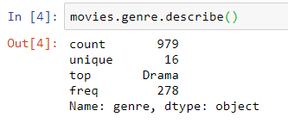
How do I explore a pandas Series?
We work on the genre and the duration of the movies DF….
Notes:
movies.genre.describe()

Slide 4
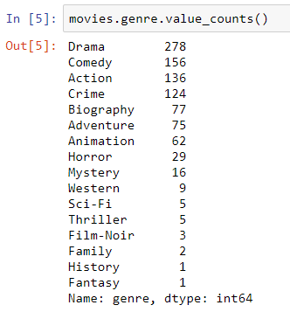
How do I explore a pandas Series?
Let’s try something similar that provides a lot more information…
Notes:
movies.genre.value_counts()

Slide 5
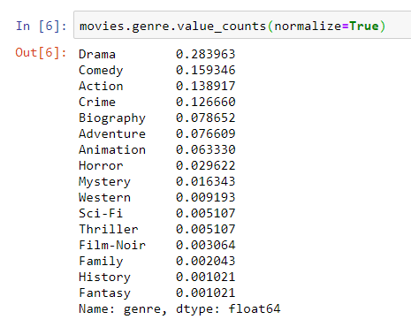
How do I explore a pandas Series?
A slight modification in the previous command to show the percent of each genre…
Notes:
movies.genre.value_counts(normalize=True)

Slide 6

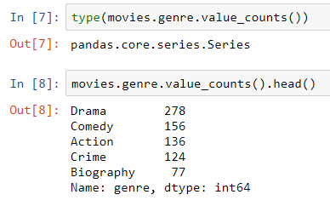
How do I explore a pandas Series?
Series and DF methods output new Series and DF objects.
You can ask what other DF or Series methods I already know that I might like to chain on to the end of current command….
Notes:
type(movies.genre.value_counts())
movies.genre.value_counts().head()

Slide 7
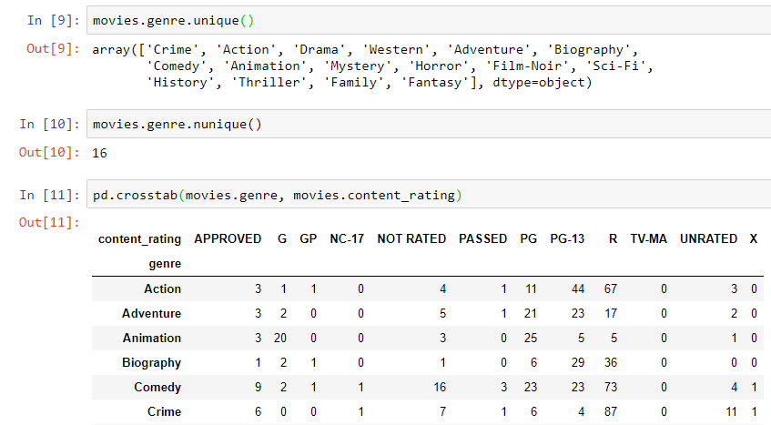
How do I explore a pandas Series?
Now we try a couple of more methods….
Notes:
movies.genre.unique()
movies.genre.nunique()
pd.crosstab(movies.genre, movies.content_rating)

Slide 8

Group Discussion
Please spend a few minutes with your team members and explain the functionality of the crosstab method in the previous slide.

Slide 9
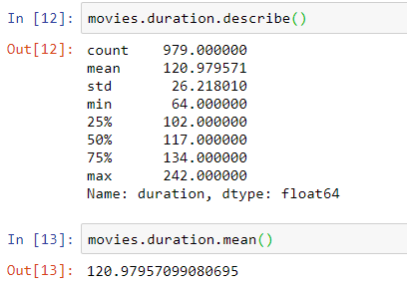
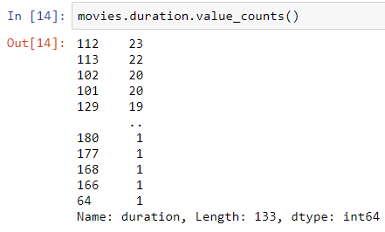
How do I explore a pandas Series?
Let’s move to the duration Series which is numerical column.
Duration
No of Movies
Useful for categorical data
Notes:
movies.duration.describe()
movies.duration.mean()
movies.duration.value_counts()

Slide 10

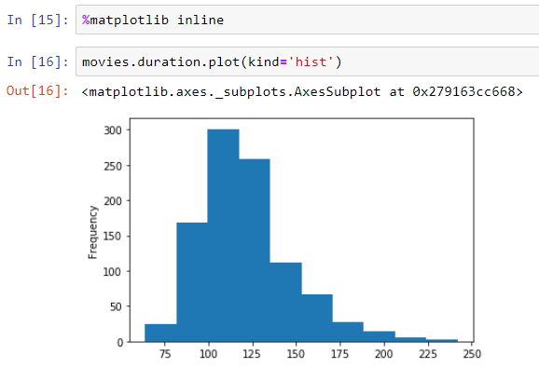
Bonus Tip
Let’s add more spice to it again ... Visualization!
This time a histogram to illustrate the distribution of durations, which is numerical variable.
Notes:
%matplotlib inline
movies.duration.plot(kind='hist')

Slide 11
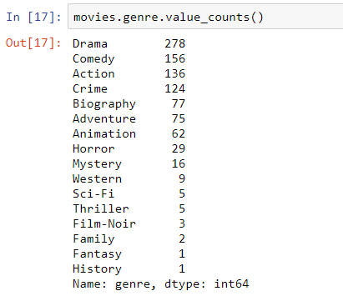
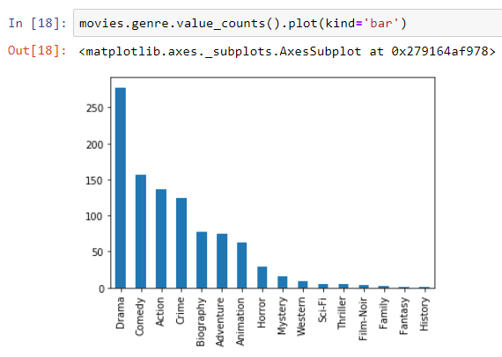
Bonus Tip
And now, another plot…
Notes:
movies.genre.value_counts()
movies.genre.value_counts().plot(kind='bar’)

Slide 12

Thank you
Question?
To be
Not to be

